Slide 1
Predictive Analysis Case Study
SUBMISSION
Linear Regression Model to Predict the price of cars and determine the factors driving car price

Slide 2
CASE STUDY OVERVIEW

Slide 3
PROBLEM STATEMENT
A Chinese automobile company Geegly Auto aspires to enter the US market by setting up their manufacturing unit there and producing cars locally to give competition to their US and European counterparts.
They have contracted an automobile consulting company to understand the factors on which the pricing of cars depends. Specifically, they want to understand the factors affecting the pricing of cars in the American market, since those may be very different from the Chinese market. The company wants to know:
- Which variables are significant in predicting the price of a car
- How well those variables describe the price of a car

Slide 4
BUSINESS GOAL
I am required to model the price of cars with the available independent variables. It will be used by the management to understand how exactly the prices vary with the independent variables. They can accordingly manipulate the design of the cars, the business strategy etc. to meet certain price levels. Further, the model will be a good way for management to understand the pricing dynamics of a new market.

Slide 5
DATA UNDERSTANDING

Slide 6
Data Reading and Understanding
The data set contains 205 entries and 29 columns. The names of those columns are:
Company, cars range, Symboling, fuel type, engine type, carbody, door number, engine location, fuel system, cylinder number, aspiration, drive wheel, Car_ID, car length, car width, car height, car volume, curb weight, Horsepower, Bore Ratio, Compression Ratio, Highway miles per gallon (mpg), Engine Size, Stroke, City Miles per gallon (mpg), Fuel economy, Peak Revolutions per Minute (rpm), Wheel Base, Price.
Here, our target variable is PRICE.

Slide 7
ASSUMPTIONS AND DATA HANDLING

Slide 8
Assumptions and Data Handling
Car Company: We have assumed that volkswagen, vokswagen, and vw are the same companies, and same for others.
Data Cleansing: We have renamed the car company names to their correct names, as per our understanding. We have converted all the data to lower case to avoid any case errors. The duplicated function searched for any duplicate values in our data and found none.
There were no missing values in the data and by performing the above steps, we prepared our data for analysis.
A separate data set corr was created that dealt only with the correlation of our target variable, price. This was done in order to select the best response variables for our study.
Another dataset cars was created that included only the columns that we selected based on our data exploration.

Slide 9
DATA EXPLORATION

Slide 10
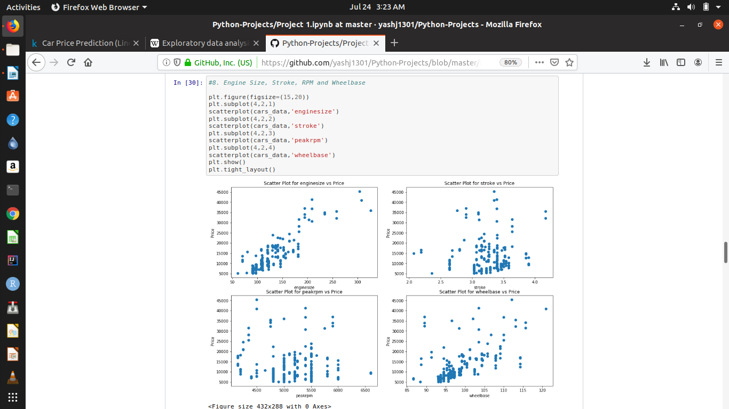
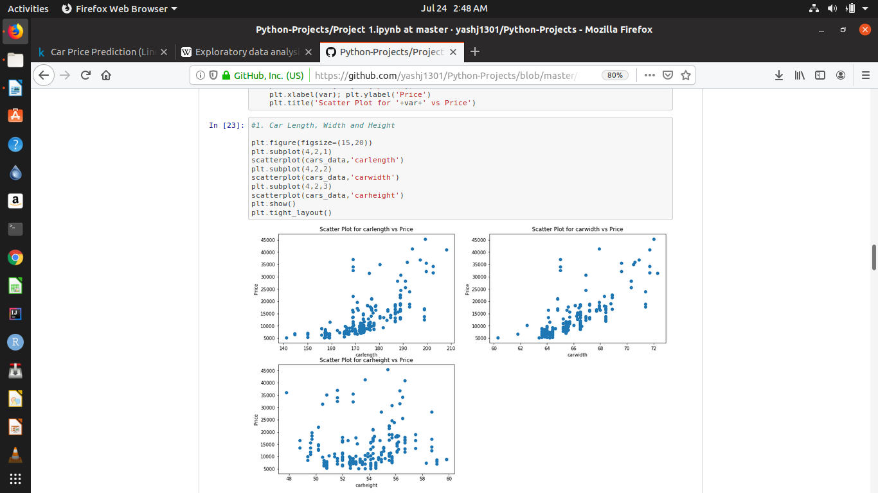
Exploratory Data Analysis
Wheel Base
It seems to have a significant positive correlation with price.
Based on our data exploration, we chose the best features that would help us predict the prices of the cars. These are :
Wheel Base, Car Length, Car Width, Curb Weight, Engine Size, Bore Ratio, Horsepower, Car Volume, Fuel Economy, Cars Range, Car Body, Fuel Type, Engine Type, Aspiration, Cylinder Number, Drive wheel
2. Car Length
It seems to have a significant positive correlation with price.

Slide 11
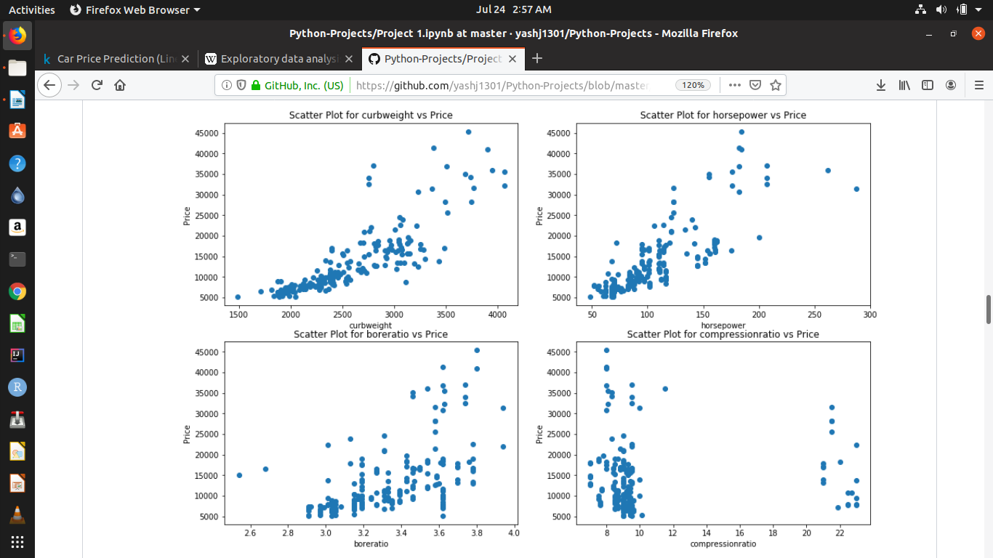
Exploratory Data Analysis
3. Car Width
It seems to have a significant positive correlation with price.
Based on our data exploration, we chose the best features that would help us predict the prices of the cars. These are :
Wheel Base, Car Length, Car Width, Curb Weight, Engine Size, Bore Ratio, Horsepower, Car Volume, Fuel Economy, Cars Range, Car Body, Fuel Type, Engine Type, Aspiration, Cylinder Number, Drive wheel
4. Curb Weight
It seems to have a significant positive correlation with price.

Slide 12
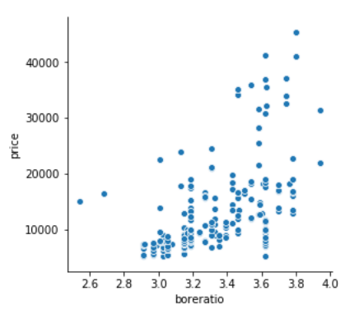
Exploratory Data Analysis
5. Engine Size
It seems to have a significant positive correlation with price.
Based on our data exploration, we chose the best features that would help us predict the prices of the cars. These are :
Wheel Base, Car Length, Car Width, Curb Weight, Engine Size, Bore Ratio, Horsepower, Car Volume, Fuel Economy, Cars Range, Car Body, Fuel Type, Engine Type, Aspiration, Cylinder Number, Drive wheel
6. Bore Ratio
It seems to have a significant positive correlation with price.

Slide 13
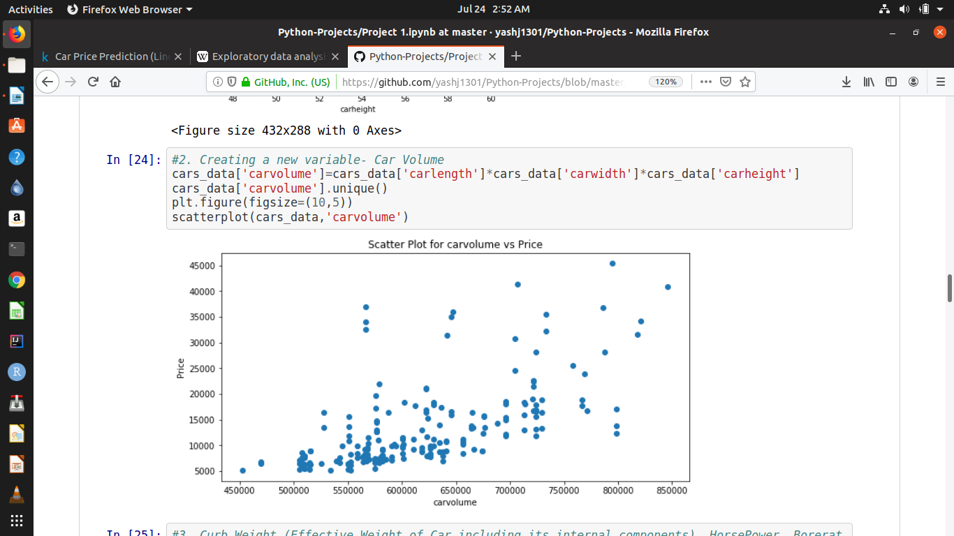
Exploratory Data Analysis
7. Horse Power
It seems to have a significant positive correlation with price.
Based on our data exploration, we chose the best features that would help us predict the prices of the cars. These are :
Wheel Base, Car Length, Car Width, Curb Weight, Engine Size, Bore Ratio, Horsepower, Car Volume, Fuel Economy, Cars Range, Car Body, Fuel Type, Engine Type, Aspiration, Cylinder Number, Drive wheel
8. Car Volume
It seems to have a significant positive correlation with price.

Slide 14
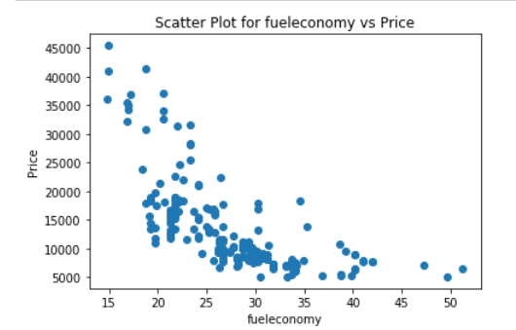
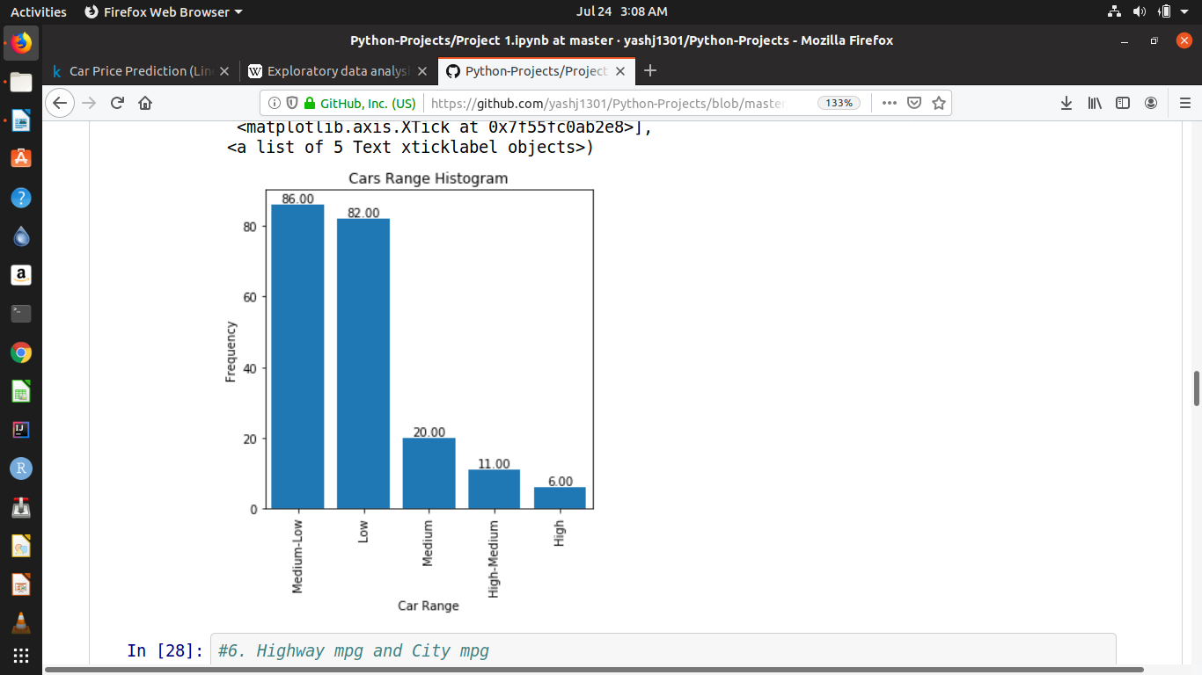
Exploratory Data Analysis
9. Fuel Economy
It seems to have a significant negative correlation with price.
Based on our data exploration, we chose the best features that would help us predict the prices of the cars. These are :
Wheel Base, Car Length, Car Width, Curb Weight, Engine Size, Bore Ratio, Horsepower, Car Volume, Fuel Economy, Cars Range, Car Body, Fuel Type, Engine Type, Aspiration, Cylinder Number, Drive wheel
10. Cars Range
It seems that most people prefer medium-low range and low range cars.

Slide 15
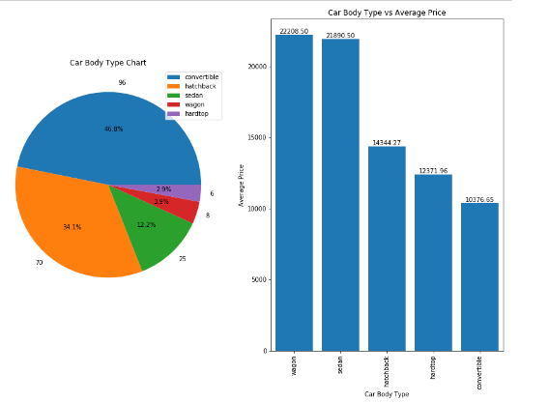
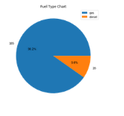
Exploratory Data Analysis
11. Car Body
It seems that people prefer convertible due to its low price range
Based on our data exploration, we chose the best features that would help us predict the prices of the cars. These are :
Wheel Base, Car Length, Car Width, Curb Weight, Engine Size, Bore Ratio, Horsepower, Car Volume, Fuel Economy, Cars Range, Car Body, Fuel Type, Engine Type, Aspiration, Cylinder Number, Drive wheel
12. Fuel Type
It seems that most people prefer gas cars despite their high price range.

Slide 16
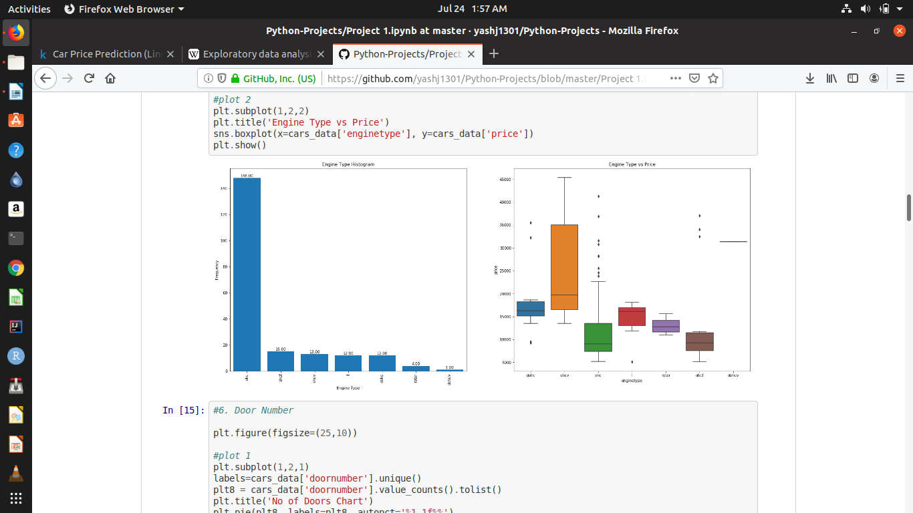
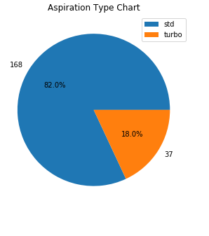
Exploratory Data Analysis
13. Engine Type
It seems that people prefer ohc engine type for their cars.
Based on our data exploration, we chose the best features that would help us predict the prices of the cars. These are :
Wheel Base, Car Length, Car Width, Curb Weight, Engine Size, Bore Ratio, Horsepower, Car Volume, Fuel Economy, Cars Range, Car Body, Fuel Type, Engine Type, Aspiration, Cylinder Number, Drive wheel
14. Aspiration
It seems that most people prefer std aspiration for their cars.

Slide 17
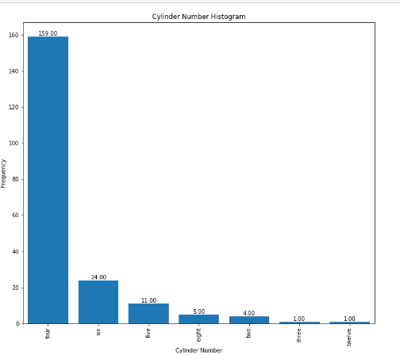
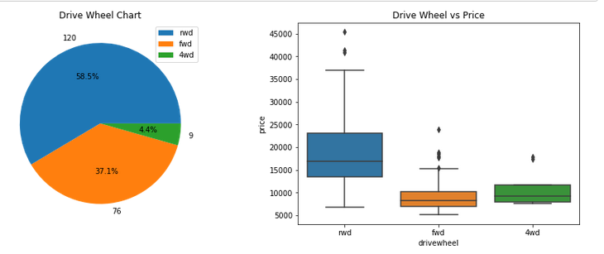
Exploratory Data Analysis
15. Cylinder Number
It seems that people prefer four cylinders for their cars.
Based on our data exploration, we chose the best features that would help us predict the prices of the cars. These are :
Wheel Base, Car Length, Car Width, Curb Weight, Engine Size, Bore Ratio, Horsepower, Car Volume, Fuel Economy, Cars Range, Car Body, Fuel Type, Engine Type, Aspiration, Cylinder Number, Drive wheel
16. Drive wheel
It seems that most people prefer rwd drive wheel despite of its high price range.

Slide 18
TECHNIQUE COMPARISON
Simple Linear Regression vs Random Forest Regression

Slide 19
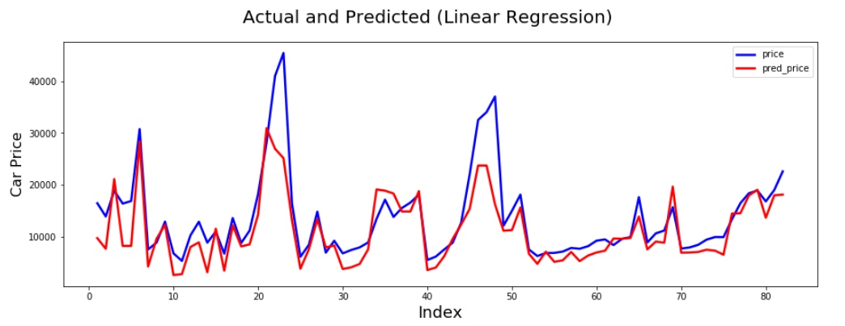
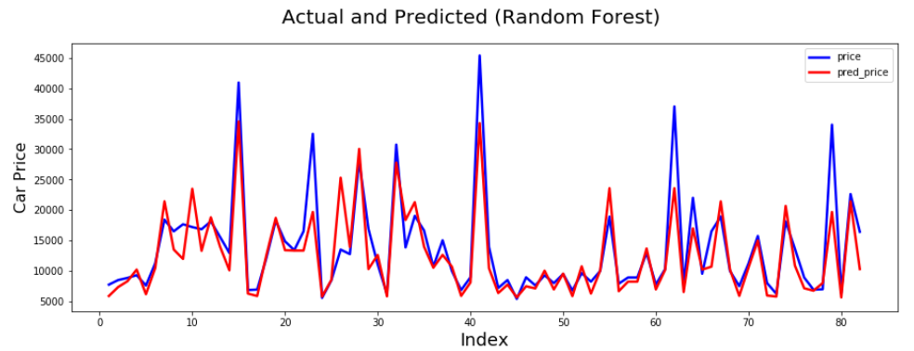
Technique Comparison
Simple Linear Regression | Random Forest Regression
In Simple Linear Regression, Our Accuracy Score was 64.377%. When plotted a graph between actual and predicted price, we could see some significant irregularities. | Using Random Forest, Our Accuracy Score was 76.147%. When plotted a graph between actual and predicted price, we noticed negligible irregularities.

Slide 20
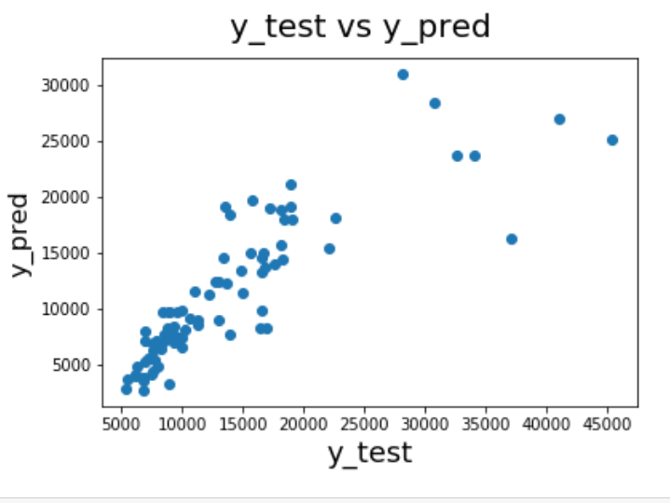
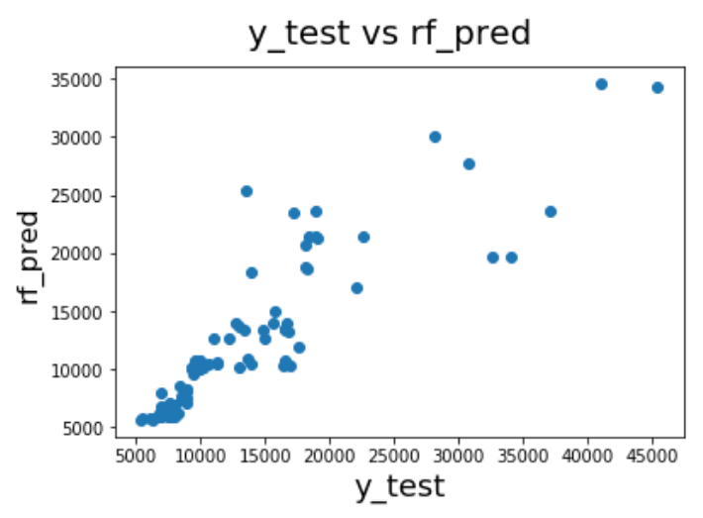
Technique Comparison
Simple Linear Regression | Random Forest Regression
When checked the price spread between values, we can clearly see some data points scattered too far away from the rest. | When checked the price spread between values, we can clearly see data points scattering only after a little while, which is earlier than what we saw in simple linear regression.

Slide 21
SUGGESTIONS AND INSIGHTS

Slide 22
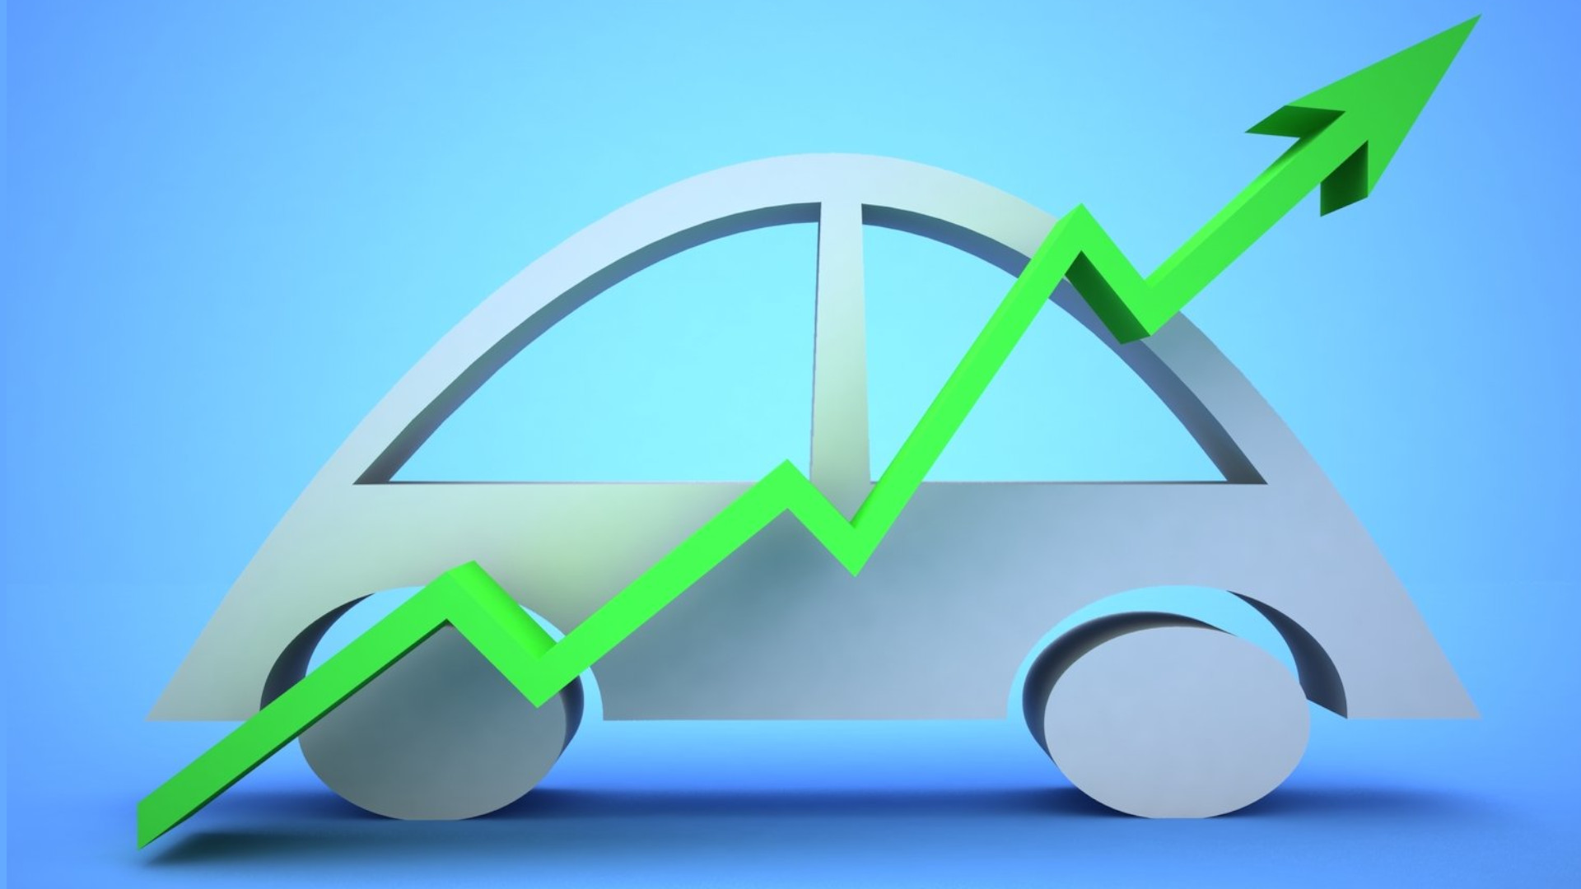
Cars Range is one of the most significant variables for deciding price. Hence, the company should select their price range within 18500$ to 30000$ initially.
Fuel Economy of the car is very important for the customers these days. The company should make sure the fuel economy of cars is not less than 5 litres/100km.
The company should make sure to have cars with drive wheel ‘rwd’ because people prefer it despite its high price.
Most of the cars should have petrol fuel type, because people prefer petrol way more than diesel.
Most people prefer convertible despite its price range being medium-high. Hence, company should focus on this as well.
Suggestions and Insights

Slide 23
A Car is an Asset to anyone who owns it. Hence, choose your car very carefully, whether for business or for personal use.
NOTE:

Slide 24

Thanks! You can access the project in the following GITHUB Repository:
https://github.com/yashj1301/Python-Projects/tree/master/Car%20Price%20Prediction
Contact details:
Yash Jain
9582617525
Greater Noida, UP-201306
yash.jain106@gmail.com
https://www.linkedin.com/in/yash-j-5537a0146/

